Slide 1
Climate Change-Induced Water Disaster and Participatory Information System for Vulnerability Reduction in North Central Vietnam (CPIS) (11-P04-VIE) Website: http://danida.vnu.edu.vn ----------------------- Closing Workshop – December 19, 2015

Slide 2
Outline
Project Activities - Overview
Project Management
Outputs/Results and Progresses
Project Progress in term of TOR
Highlight Results
Further Activities

Slide 3
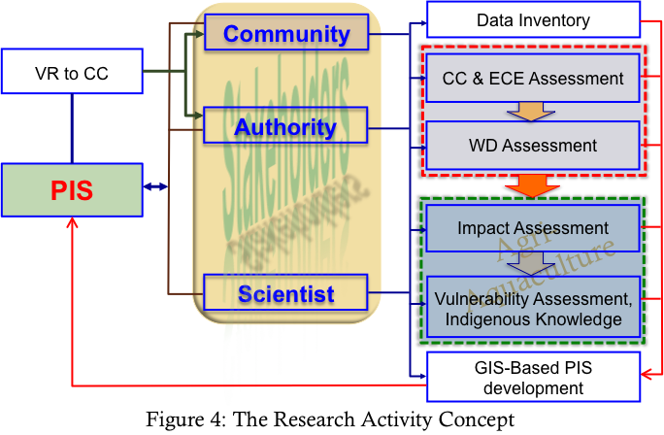
Project Activities (1)
WP1: Data inventory
WP3: Assessment of Climate Change and Extreme Climate Events
WP4: Water Disaster Assessment and Analysis
WP2: Indigenous Knowledge Integration
WP5: Impact and Vulnerability Assessment
WP6: GIS-based Participatory Information System Development

Slide 4
Project Activities (2)
RESEARCH ACTIVITIES
WP1: Data inventory
WP2: Indigenous Knowledge Integration
WP3: Assessment of Climate Change and Extreme Climate Events
WP4: Water Disaster Assessment and Analysis
WP5: Impact and Vulnerability Assessment
WP6: GIS-based Participatory Information System Development
OTHER ACTIVITIES
WP7: Training and Staff Exchange
WP8: Provision Of Equipment
WP9: Dissemination
For more detail: http://danida.vnu.edu.vn/cpis/en/cat/17

Slide 5
PROJECT MANAGEMENT
VNU
DFC
MOST
HUS
Project Management Board
Project Director
VN Teams
DN Teams
Project Activities

Slide 6
Outputs/Results
No | Expected | Last Outputs
1 | An integrative working model to establish the information system | Working teams: Scientists, Autorities and Communities
2 | A Participatory Information System (PIS) for vulnerability reduction and resilience enhancement | Web-based PIS in Vietnamese: http://danida.vnu.edu.vn:8083/
3 | Human resources: 3 PhD and 4 Master students, training workshops for local community | 4 PhD and 4 MSc students have been involved in the project. 01 PhD & 03 MSc succefully defensed their Thesis 02 training workshops for local people
4 | Publicastions: 3-4 peer-reviewed articles | 7 ISI papers, 10 workshop/conf proceedings, 02 Joint papers
5 | Reinforced collaboration and cooperation between scientists | Interdisciplinary and International Working Teams, Joint Field Surveys

Slide 7
Project Progress in term of TOR
WP2: Indigenous Knowledge Integration
Leaded by Dr. Luu Bich Ngoc
No | Outputs/Results | Progress
1 | Scientific reports on Study design, field survey manuals, Methodologies and results of data processing, data analysis on IK in adaptation to CC-induced WD | Done
2 | Field surveys, data collection on IK | Done
3 | Construction of database on IK in adaptation to CC-induced WD for PIS | Almost Done?
4 | 2 peer-reviewed articles published in international journals | 01 Conf. Proc. 01 Joint Paper ?

Slide 8
Project Progress in term of TOR
WP3: Assessment of CC and ECEs
Leaded by Dr. Ngo Duc Thanh
No | Outputs/Results | Progress
1 | Scientific reports on Observed and Projected CC and ECE Change in NHQ | Done
2 | Extracting CC data for WP4 | Done
3 | Construction of database on CC for PIS | Done
4 | 2 peer-reviewed articles published in international journals | 04 ISI papers and 04 Conf. Proceedings
5 | 1 PhD and 2 MSc Students | 02 PhD and 02 MSc students

Slide 9
Project Progress in term of TOR
WP4: Water Disaster Assessment and Analysis
Leaded by Dr. Tran Ngoc Anh
No | Outputs/Results | Progress
1 | Scientific reports on Assessment of WD and Vulnerability caused by CC-induced WD to the agriculture and aquaculture sectors | Done
2 | WD maps in accordance to CC scenarios | Done
3 | Standardized database to the PIS | Done
4 | 2 peer-reviewed articles published in international journals | 02 Conf. Proc., 01 Joint paper, 01 ISI paper?
5 | 1 PhD and 1 MSc Students | 02 PhD and 01 MSc students

Slide 10
Project Progress in term of TOR
WP5: Impact and Vulnerability Assessment
Leaded by Dr. Man Quang Huy
No | Outputs/Results | Progress
1 | Scientific reports on assessment of CC-induced WD to socio-economic structures and infrastructures and Analysis of adaptive possibility of stake holders and proposals of the policy of the integration of the adaptation to CC into the “New rural development programme” | Done
2 | Report on Vulnerability of agriculture and aquaculture to CC | Done
3 | Standardized database to the PIS | Almost Done?
4 | 2 peer-reviewed articles published in international journals | 02 Conf. Proc, 01 Joint paper?
5 | Training | 01 MSc students

Slide 11
Project Progress in term of TOR
WP6: GIS-based PIS Development
Leaded by Dr. Bui Quang Thanh and MSc Nguyen Trung Kien
No | Outputs/Results | Progress
1 | Online GPIS installed on server with complete database, working properly | Almost Done
2 | GPIS document | In Progress
3 | Training for local people | 02 training workshops, 01 more?
4 | 1 peer-reviewed articles published in international journals | 01 Conf. Proceedings 01 more ISI paper?

Slide 12
Project Progress in term of TOR
Summary of TOR of Danish researchers’ Contributions to the WPs
No | Full name | WP2 | WP3 | WP4 | WP5 | WP6 | Papers | Progress
1 | Dr. Ole Bruun | X |  |  | X | X | 2 | ?
2 | Dr. Thorkil Casse |  | X | X | X | X | 2 | 1
3 | Dr. Mogens Buch-Hansen | X |  |  | X | X | 2 | 1
4 | Dr. Olivier Rubin |  |  | X | X | X | 2 | 1
5 | Dr. Mette Fog Olwig |  |  |  |  | X | 2 | ?

Slide 13
Highlight Results
Scientific papers: 7/4 ISI, 10 Proceedings
Capacity building:
03 Researchers visited Japan and RUC for writing papers
3 PhD students have been sending to short training abroad
10 researchers participated International Workshops/Conferences
Interdisciplinary Team Working
PIS: Weather forecast Component has been added
Close cooperations with local people

Slide 14
Limitations/Weaknesses
Training: 4/3 PhD and 4/4 MSc Students
01/04 PhD, 03/04 MSc succefully defensed thesis
PIS: Not meet the requirements as expected
It is not easy to understand for most local people
Other?

Slide 15
Further Works
To improve the PIS
At least 03 training workshops for local people
To complete the final project report in Vietnamese
Wrting final report to DFC, including accouting report
Need contributions from the Danish Partner

Slide 16
Thank you very much

